Slide 1

Package Managers for Windows
Sarah Lean
Glasgow Azure User Group
@Techielass
www.techielass.com

Slide 2



Who am I?
Senior Solutions Architect @ Octopus Deploy
Blog at www.techielass.com
@Techielass
Founder of the Glasgow Azure User Group
STEM Ambassador
17+ years in the IT industry
IT Pro

Slide 3
Glasgow Azure User Group
Feb 2017 – Idea formed
May 2017 – First meetup
April 2018- Part of the Global Bootcamp event
Aug 2020 – hit 20 meetups
First Scottish Azure User Group
Second azure user group in uk
Glasgow Azure User Group | @Techielass

Slide 4



Sarah Lean
Gregor Suttie
Glasgow Azure User Group | @Techielass

Slide 5
Independent body
Community driven
Open and inclusive
Meetup every two months
Free to attend
Legendary quiz
Glasgow Azure User Group | @Techielass

Slide 6
In 2018 we gave away 610 stickers!
Glasgow Azure User Group | @Techielass

Slide 7
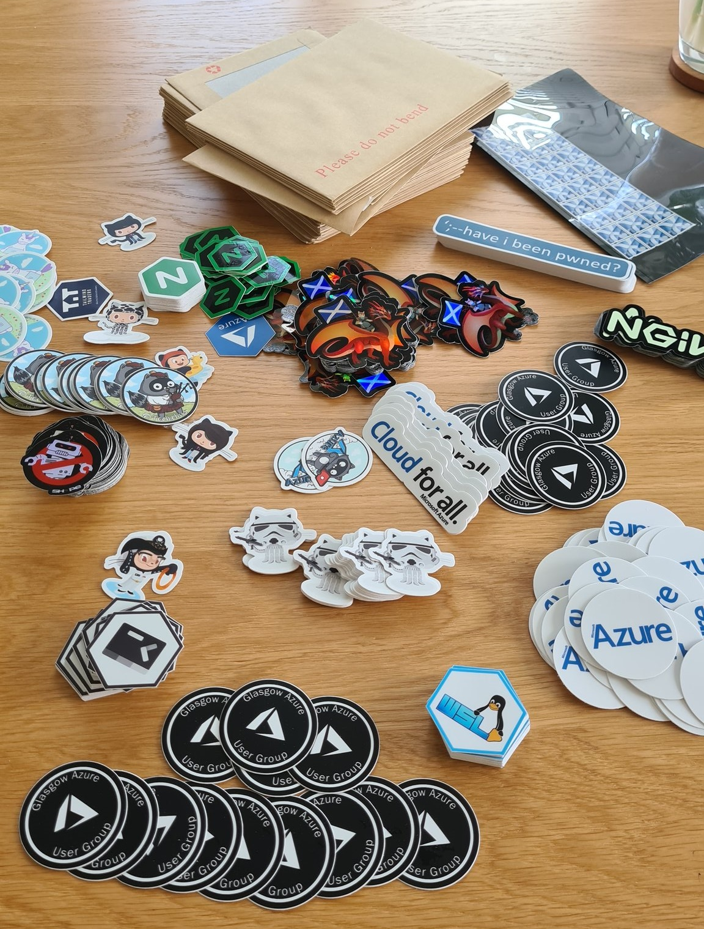

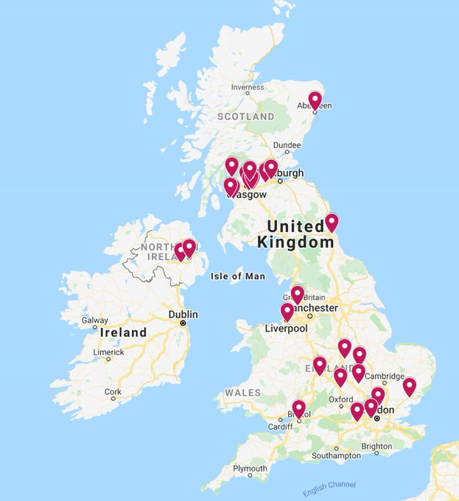
In 2020 we did sticker packs since we couldn’t meet in person.
Glasgow Azure User Group | @Techielass

Slide 8
Opened up job opportunities
Helped new speakers gain experience
Continued virtually during the pandemic
Newsletter & social media presence
Glasgow Azure User Group | @Techielass

Slide 9
Big thank you to our sponsors for their continued support
Glasgow Azure User Group | @Techielass

Slide 10
PACKAGE MANAGERS FOR WINDOWS
Glasgow Azure User Group | @Techielass

Slide 11
What is a package manager?
Glasgow Azure User Group | @Techielass

Slide 12




Slide 13

What about the Windows ecosystem?

Slide 14
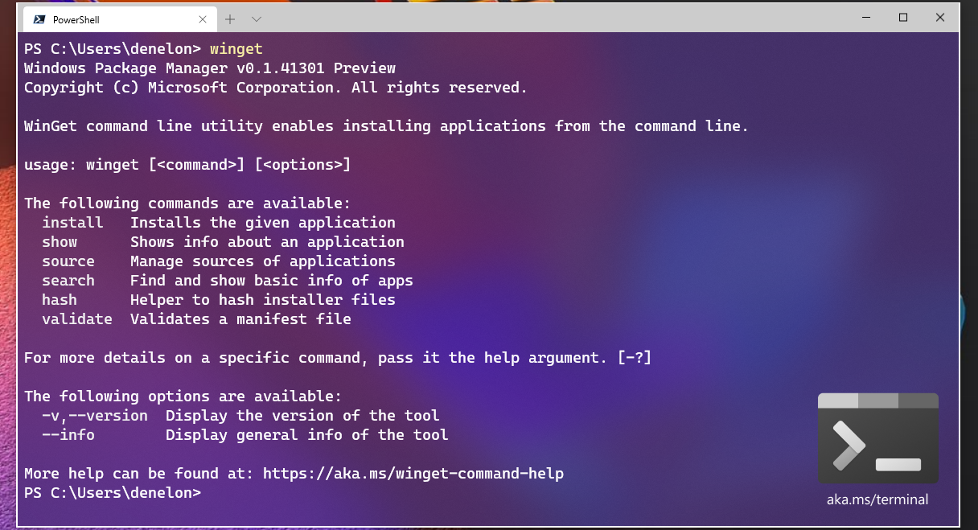
What about the Windows ecosystem?

Slide 15




Chocolatey
Supported Operating Systems
Open Source
Free & Paid Versions

Slide 16
Install Chocolatey
Manual install
Automate with Ansible, Chef, Puppet, PowerShell DSC, etc

Slide 17
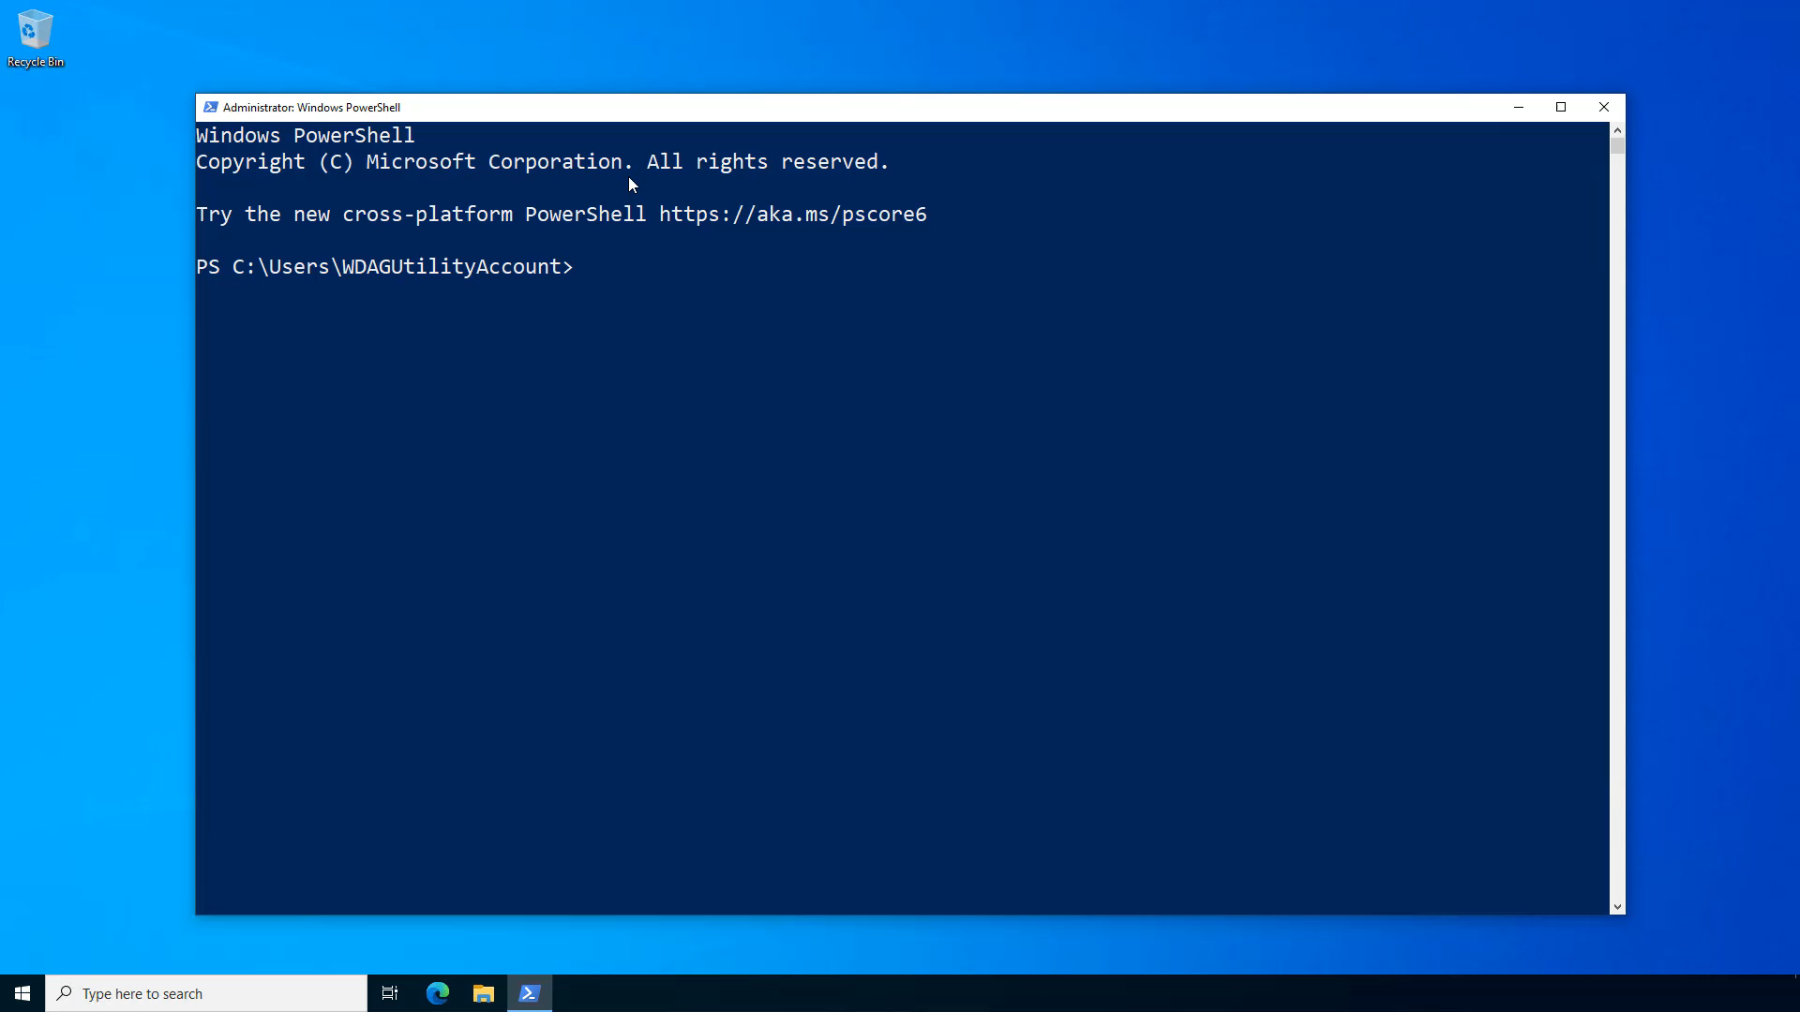

Slide 18
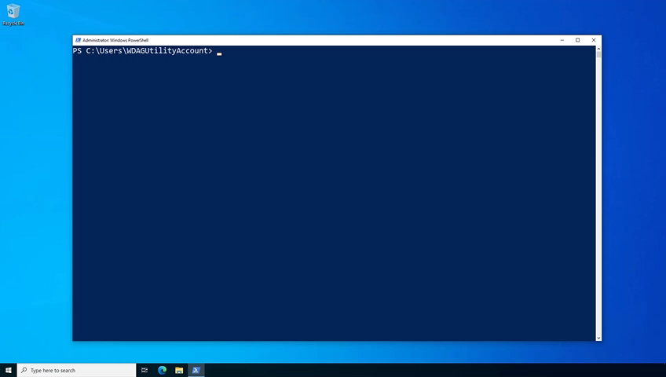
Search for packages

Slide 19
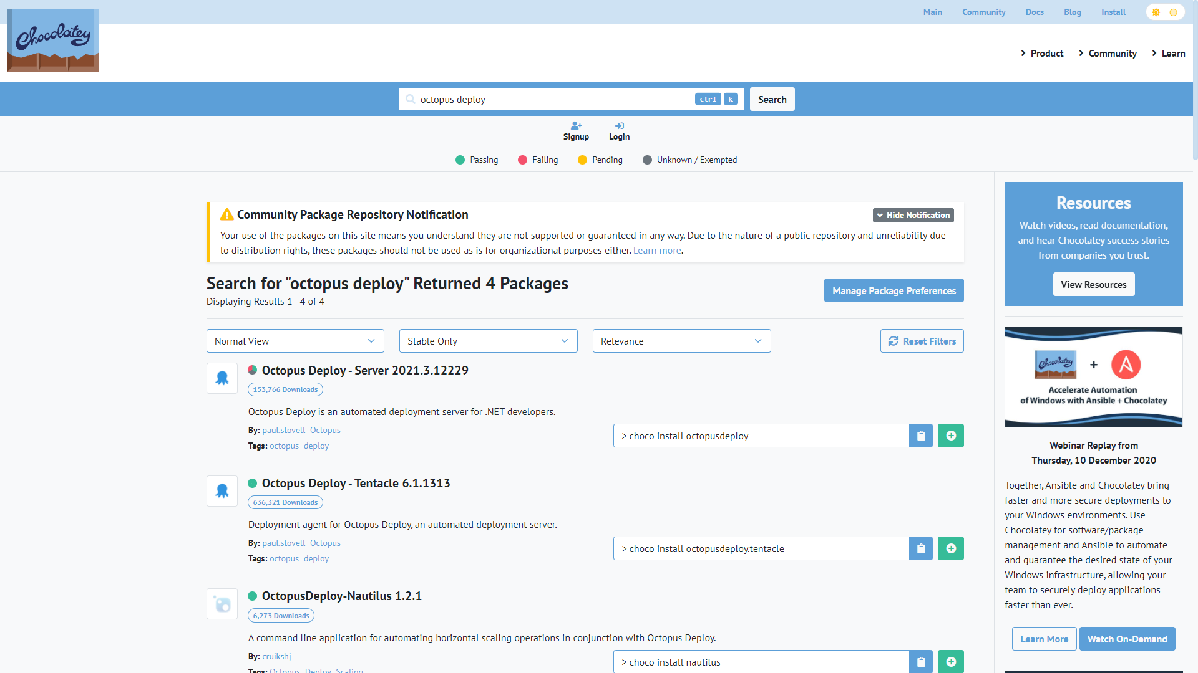
Search for packages

Slide 20
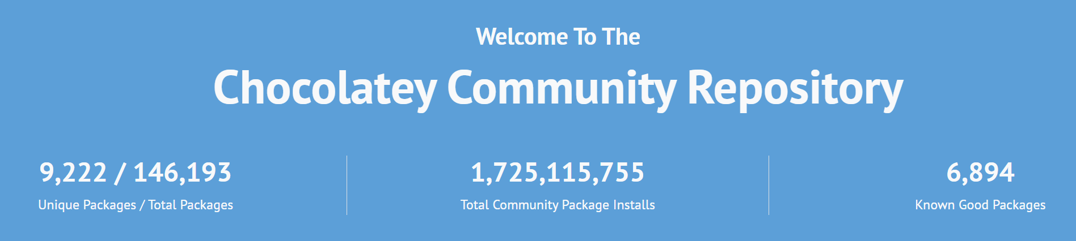
Where do the packages come from?
Community repository
Build your own repository

Slide 21
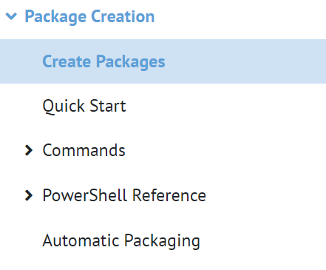
Contributing
Anyone can contribute
choco new –h
- GUI package builder available for business customers

Slide 22

Advanced Commands
choco outdated
- Show packages that are out of date
choco upgrade all --except="'skype,git’”
- Upgrade all packages except Skype and Git
choco install packagename –x86
- Force x86 installation on 64 bit system

Slide 23



Windows Package Manager
Open Source
Supported Operating Systems
Free

Slide 24
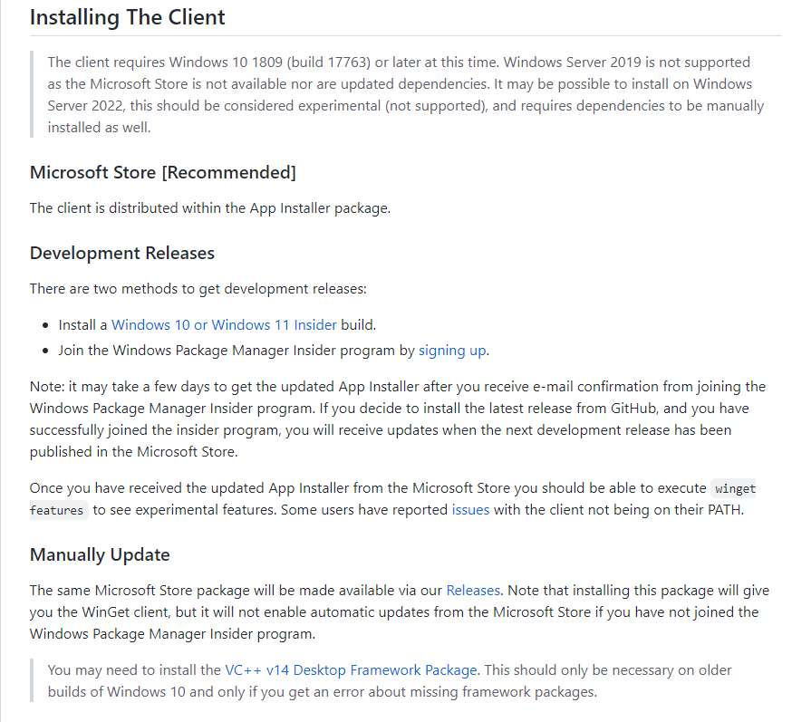
Install winget
Microsoft Store
Manual install
Windows Insider builds

Slide 25
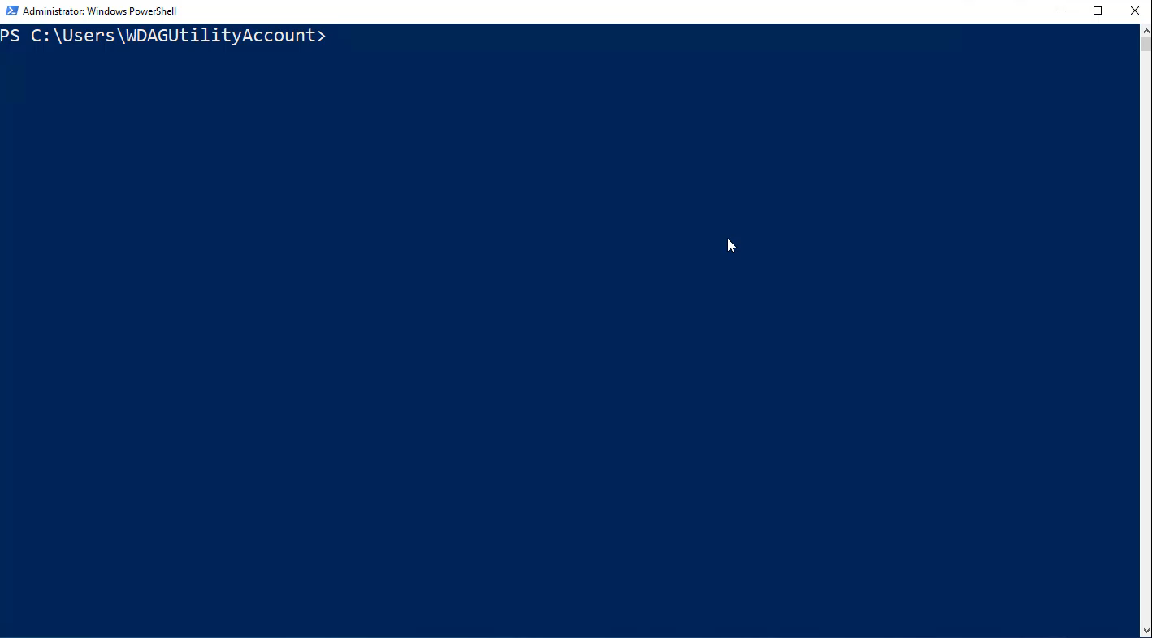
Search for packages

Slide 26
Where do the packages come from?
Microsoft Store
Public/Community Repository
Private Repository

Slide 27
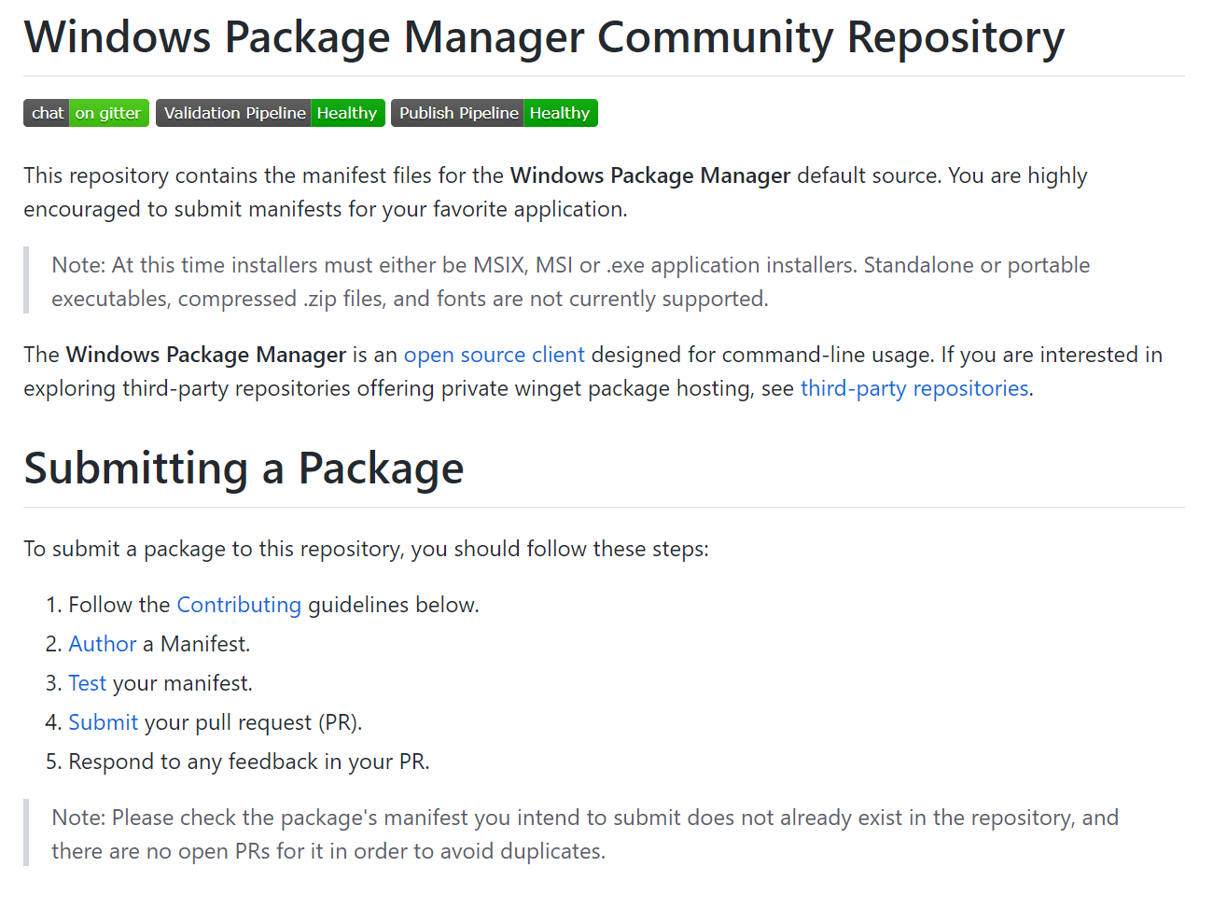
Contributing
Anyone can contribute
Windows Package Manager Manifest Creator

Slide 28
Advanced Commands
winget install --id packagename.packagename --silent
- No display boxes
winget install --id packagename.packagename --version 1.62.0
- Specify the version to install
winget upgrade --all
- Upgrades all installed software

Slide 29
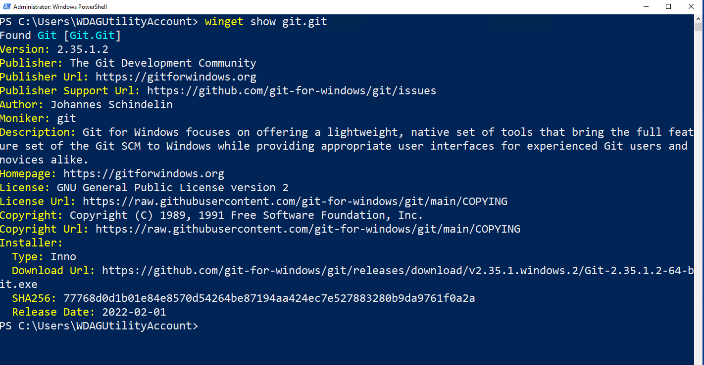
Advanced Commands
winget show git.git

Slide 30
Ever needed to replicate the installed software from one machine to another?
Glasgow Azure User Group | @Techielass

Slide 31

Exporting and Importing

Slide 32
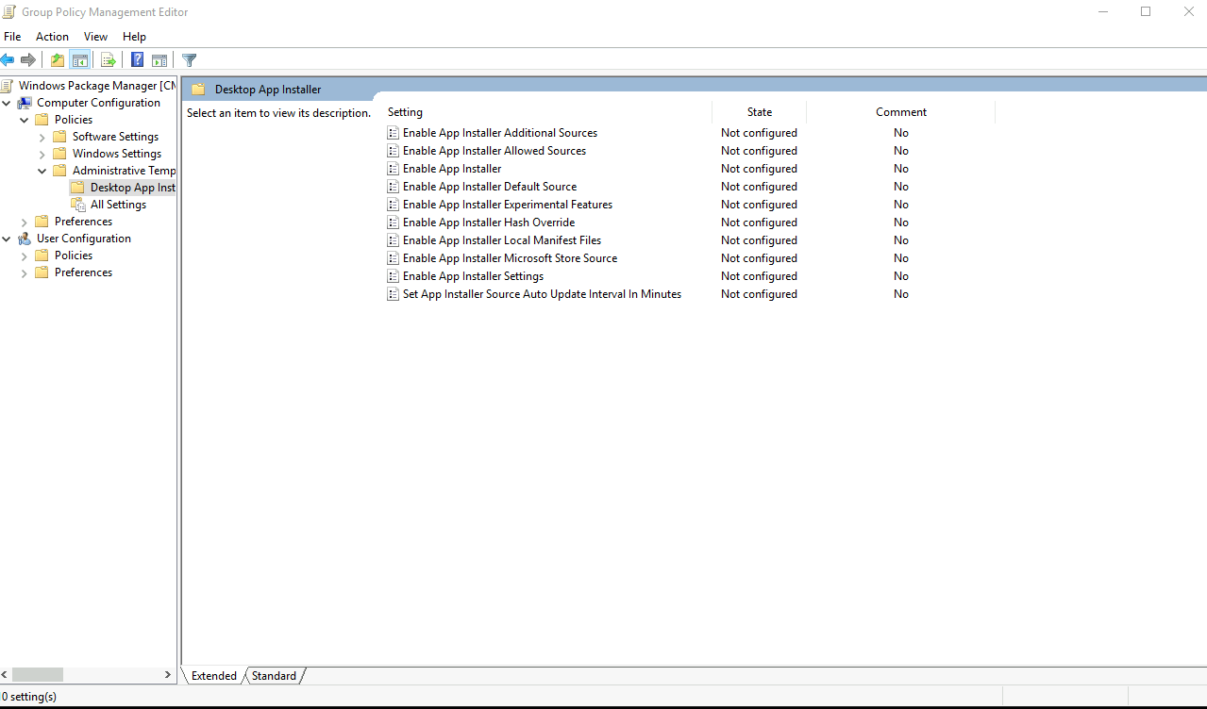
Group Policy for Windows Package Manager

Slide 33
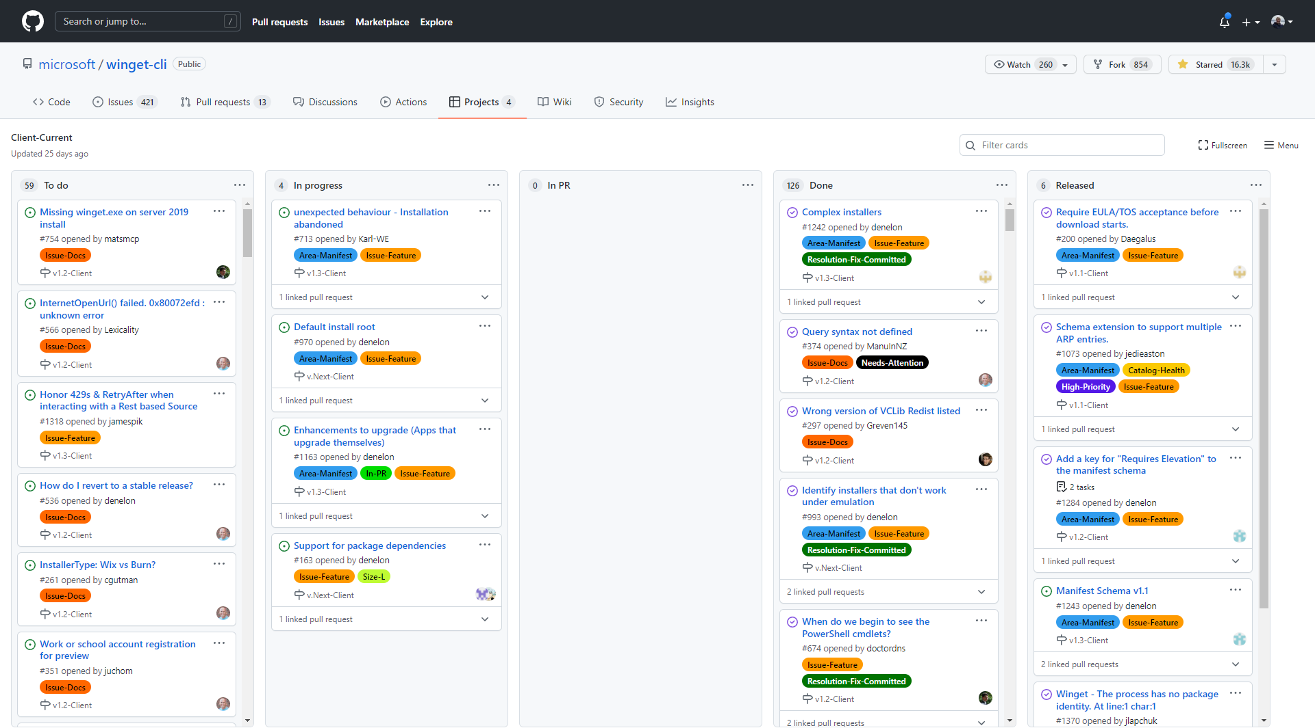
Roadmap
https://github.com/microsoft/winget-cli/projects

Slide 34
Which one should you use?
Glasgow Azure User Group | @Techielass

Slide 35

Thank you! Resources: https://bit.ly/winpackmanagers
Sarah Lean
Glasgow Azure User Group
@Techielass
www.techielass.com

